Slide 1


BANK LOAN ANALYSIS
Comprehensive Portfolio Performance & Risk Insights Report
DATA ANALYTICS PROJECT 2026

Slide 2



PROJECT CONTEXT & SCOPE
Objective
To evaluate loan applications, funded amounts, and repayment patterns to optimize approval strategies and reduce bad debt risk.
Dataset Overview
•
Dimensions: Status, Term, Purpose, Home Ownership
•
Source: Financial Loan Registry (SQL Server)
•
Analytics: KPIs, Trends, and Regional Heatmaps

Slide 3
OPERATIONAL KPIS SUMMARY
38.6K
$436M
$473M
TOTAL APPLICATIONS
FUNDED AMOUNT
AMOUNT RECEIVED
12.05%
13.33%
AVG INTEREST RATE
AVG DTI RATIO

Slide 4
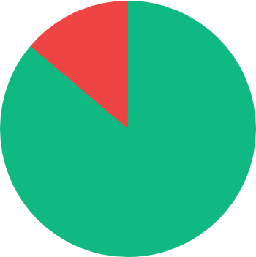
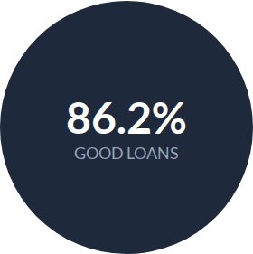
PORTFOLIO RISK ASSESSMENT
Good Loans: 33.2K Applications $370.22M Received
Bad Loans: 5.3K Applications (13.8%) $37.28M Received

Slide 5
LOAN STATUS PERFORMANCE
Loan Status | Applications | Funded Amount | Rec. Amount | Avg DTI
Fully Paid | 32,145 | $351,358,350 | $411,586,256 | 13.17%
Charged Off | 5,333 | $65,532,225 | $37,284,763 | 14.00%
Current | 1,098 | $18,866,500 | $24,199,914 | 14.72%

Slide 6
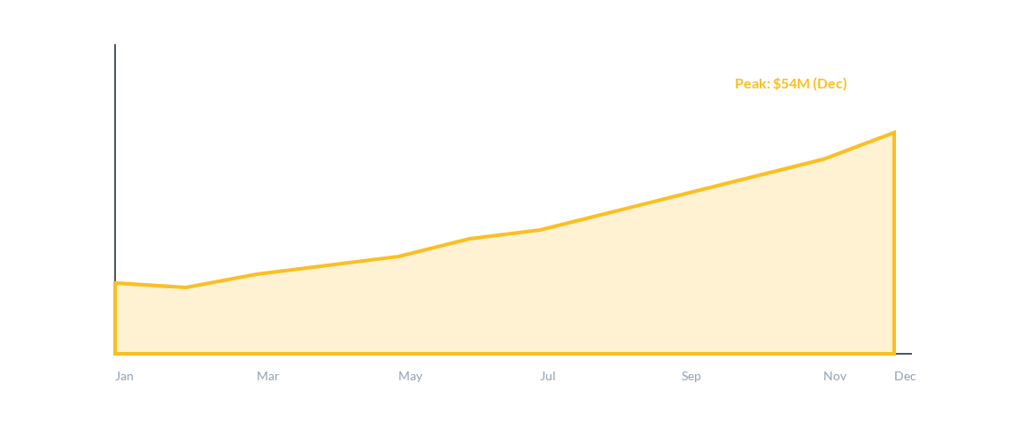
MONTHLY LENDING PATTERNS
Steady MoM growth in funded amounts, peaking in Q4.

Slide 7

REGIONAL DISTRIBUTION
Market Concentration
The loan portfolio shows strong regional concentration in high-population states.
•
California (CA): 6,894 Applications
•
Florida (FL): 2,773 Applications
•
Georgia (GA): 1,355 Applications
•
Massachusetts (MA): 1,310 Applications

Slide 8
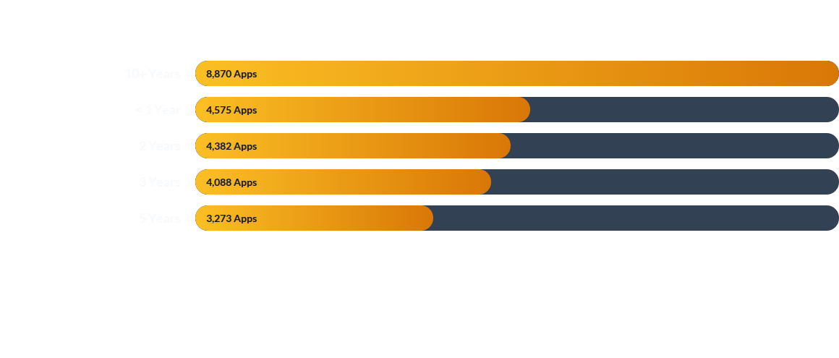
EMPLOYMENT LENGTH IMPACT
Stable employment (10+ years) correlates with higher loan volume and stability.

Slide 9





PRIMARY LOAN PURPOSES
Debt Consolidation
Credit Card
Home Improvement
18,214 Applications ($232M Funded)
4,998 Applications ($58M Funded)
2,876 Applications ($33M Funded)

Slide 10

HOME OWNERSHIP SEGMENTS
Rent & Mortgage
Home Owners
The vast majority of borrowers fall into the Rent (18,439) or Mortgage (17,198) categories.
The "OWN" category represents a smaller, likely more stable segment of the portfolio.
•
Rent Total: $185.7M Funded
•
Own Total: 2,838 Apps
•
Mortgage Total: $219.3M Funded
•
Received: $31.7M

Slide 11
STRATEGIC ROADMAP
Risk Mitigation: Tighten approval criteria for high-DTI and low-credit-grade segments to reduce Charge-Off rates.
Product Focus: Enhance debt consolidation products as they drive nearly 50% of application volume.
Retention: Target the 10+ year employment segment with loyalty benefits and faster approval tracks.
Operational Efficiency: Invest in high-performing states (CA, FL, GA) during seasonal peak in Q4.

